Slide 1
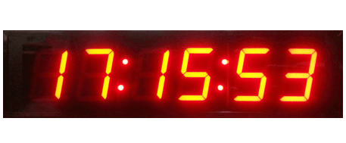
Digital Clock design
In this presentation we are going to explain how we get through the procedure of designing a digital clock system. We will describe every part we built and used inside the main clock circuit. Also How we achieved the elements reusability into our implementation. What problems we faced, And How we take care of them to finally reach the correct working of the system. We begin with each element low-level design then through the assembling process, finally the whole mechanism description.

Slide 2

Synchronous sequential circuit
These circuits uses clock signal and level inputs (or pulsed) (with restrictions on pulse width and circuit propagation). The output pulse is the same duration as the clock pulse for the clocked sequential circuits. Level output changes state at the start of an input pulse and remains in that until the next input or clock pulse

Slide 3
4-bit Binary Counter Using D Flip-flops
We design a circuit for an edge triggered 4-bit binary up counter (0000 to 1001). When it reaches “1001”, it should revert back to “0000” after the next edge and so on in other counters .
Use positive edge triggered D flip-flop to design the circuit
We need to design a 4 bit up counter. So, we need 4 D-FFs to achieve the same.

Slide 4
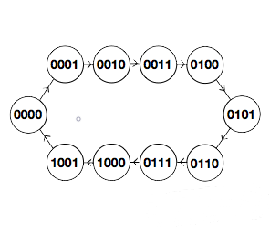
the state diagram of the 4-bit up counter
synchronous counters count on the rising-edge which is the low to high transition of the clock signal
Synchronous Counter all FFs receive the common clock pulse, and the change of state is determined from the present state.

Slide 5
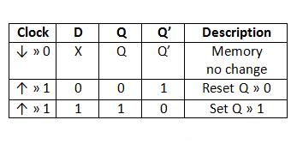
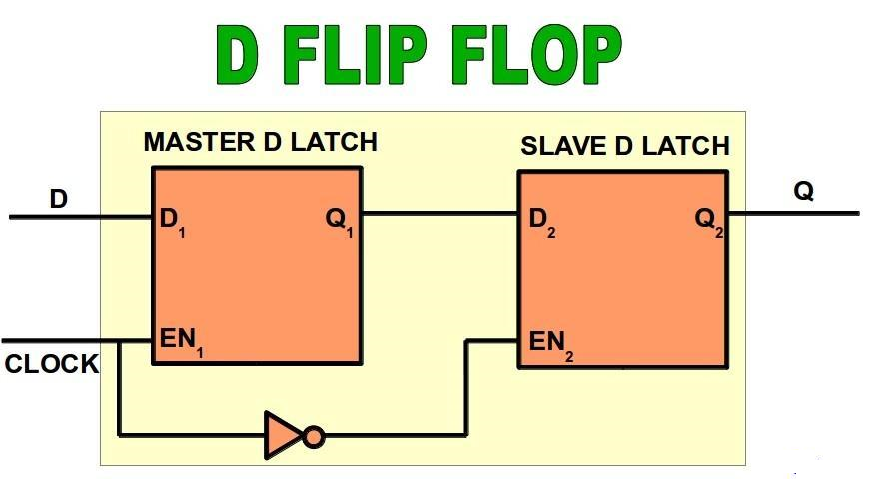
Truth Table for the D-type Flip Flop
The characteristic equation for the D-FF is: Q+ = D
It’s Circuit Diagram

Slide 6
Constructing the truth table for the 4-bit up counter using D-FF
At first the Operation will be as follow : The least significant bit (Q0) is complemented with each negative-edge clock pulse input.
Every time that Q0 goes from 1 to 0, Q1 is complemented.
Every time that Q1 goes from 1 to 0, Q2 is complemented.
Every time that Q2 goes from 1 to 0, Q3 is complemented, and so on.
Now we can construct the present state and the next one and the input of the D-FF using it’s characteristic equation : Q+ = D .

Slide 7
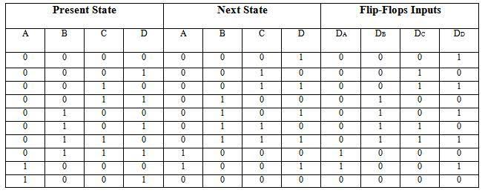
Construct the State Table for the 4-bit up counter using D-FF
State Table for 4-bits binary counter

Slide 8
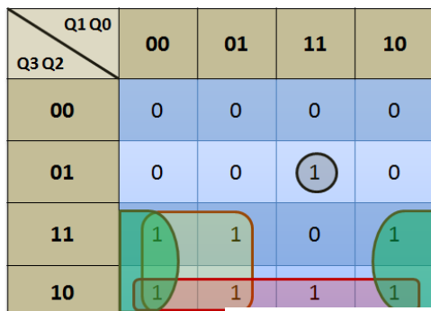
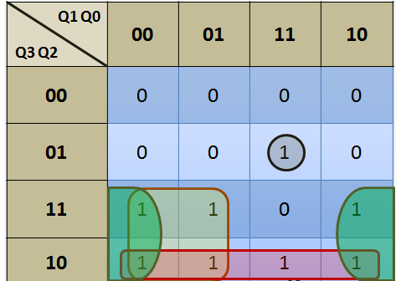
Now constructing the K-Maps and finding out the logic expressions for D3, D2, D1, D0
D3 K-map D2 K-map D2= Q2 ⊕(Q1Q2) D3 = Q3 ⊕ (Q2Q1Q0)

Slide 9
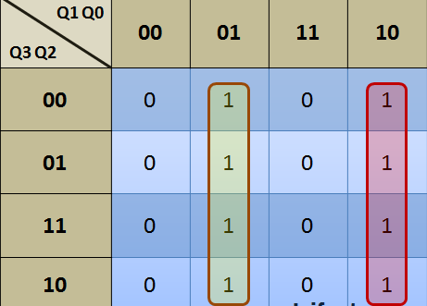
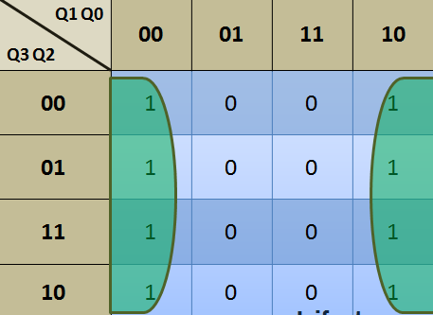
CONTINUED….
D1 K-map D0 K-map D1=Q1 ⊕ Q0 D0= Q’

Slide 10
Implementing the counters in Logisim
After we get the 4 expressions of each input of the FF and simplify it we will implement the gates of each input to it’s FF consecutively to get our counter 9-counter When it reaches “1010”, it should revert back to “0000” after the next edge(through the overflow pin) …so we take the Q3,Q1 through AND gate .the output of the AND gate will be the overflow pin which is connected to the RESET of the FFs as shown in the next slide.

Slide 11
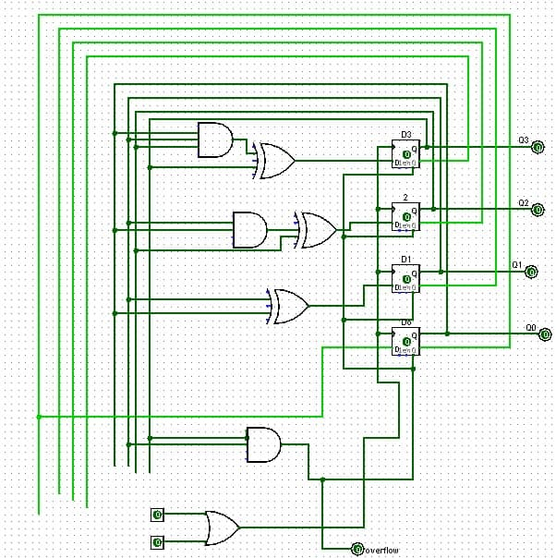

Slide 12
CONTINUED….
Tens-counter When it reaches “0110”, it should revert back to “0000” after the next edge(through the overflow pin) as the seconds minutes has the maximum tens digit of 5… so we take the Q2,Q1 through AND gate .the output of the AND gate will be the overflow pin which is connected to the RESET of the FFs as shown in the next slide. This help us to determine each min or sec passes

Slide 13
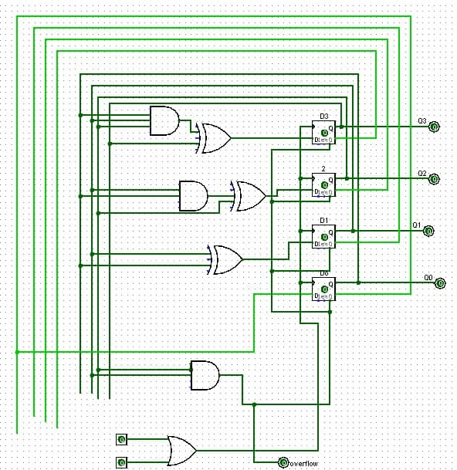

Slide 14
Constructure of the hours counter ..
Counting the hours required a special use of a 4-bit counter.. Again, we preferred to separate the ones from its tens during counting, in order to facilitate the process of displaying the number on the segment.. But we encountered a problem in the beginning, which was to perform a clearing process for each of the used counters at the required time. For example, the first counter has to be cleared when the digit goes past 9, but it also needs to be cleared when the digit goes beyond 1, if the tens counter carries the number 1. In addition to clearing the tens counter at the same time

Slide 15
CONTINUED….
This problem made it difficult to design the hour counter in the same way that the minute and second counters were designed. To achieve a simple counter design works for that purpose we preferred to avoid doing complex analysis with state tables and try to think out of the box.. Here, we came with the idea of using 4-bits binary simple asynchronous (Ripple) counter, and utilize two of it in order to count the required number of hours separately.

Slide 16
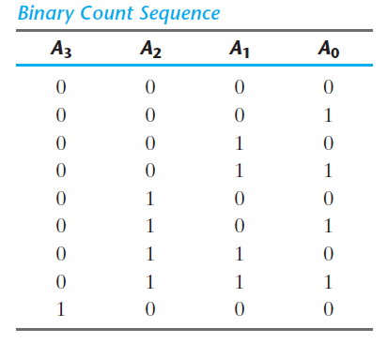
In the beginning.. we designed the Ripple counter
the operation of the four‐bit binary ripple counter, refer to the first
nine binary numbers listed in the Table. The count starts with binary 0 and increments
by 1 with each count pulse input. After the count of 15, the counter goes back to 0 to
repeat the count. The least significant bit, A0, is complemented with each count pulse
input. Every time that A0 goes from 1 to 0, it complements A1. Every time that A1 goes
from 1 to 0, it complements A2. Every time that A2 goes from 1 to 0, it complements A3,
and so on for any other higher order bits of a ripple counter.

Slide 17
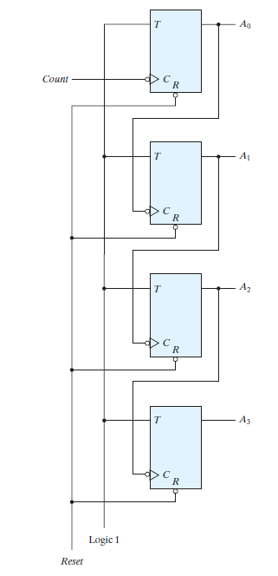
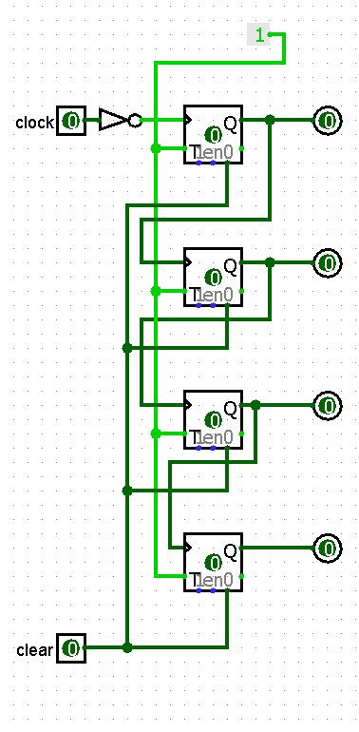
Implementing The Ripple counter
A binary ripple counter consists of a series connection of complementing flip‐flops, with
the output of each flip‐flop connected to the C input of the next higher order flip‐flop.
The flip‐flop holding the least significant bit receives the incoming count pulses. A complementing
flip‐flop can be obtained from a T flip‐flop.

Slide 18
Control the counters Over-Flow
In order to control the end that each of the counters will reach before the value it carries is cleared, we designed a simple feedback system by ANDing the output of each of the counters, which headline the number that indicates the overflow .. The output of the AND gate goes through the clear pin of the desired counter to be cleared at that Over-Flow.. Another procedure must be taken into consideration that the ones digit counter has two label numbers over flow.
Over-flow after 9 (when the tens digit is zero)
Over-flow after 1 (when the tens digit has one)

Slide 19
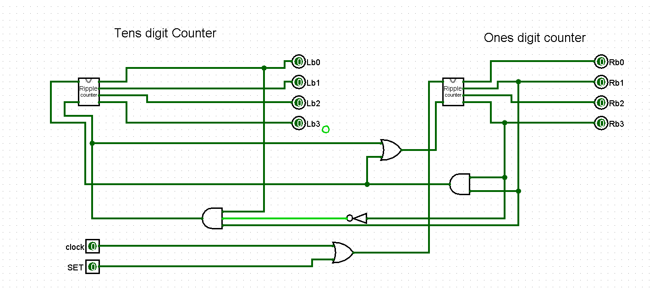
Here’s our Implementation for the Hours-counter we used 2 AND gates along the counters to indicate such overflows .. Also, an OR gate for the clear pin of the ones digit counter as it has two over-flow conditions.

Slide 20
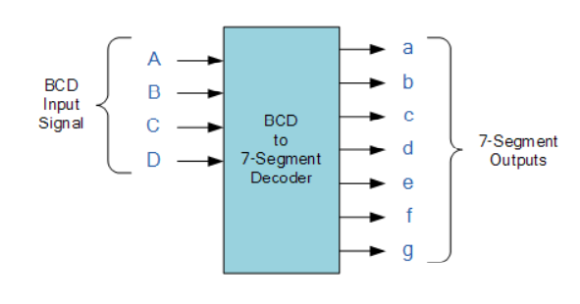
BCD to 7 Segment Decoder
A binary coded decimal (BCD) to 7-segment display decoder is an IC that has 4 BCD inputs and 7 output lines, one for each LED segment. So we can represent numbers from 0 to 9 using it.

Slide 21
The implementation of BCD Decoder
The purpose of decoder is to generate the minterms of n input variables. Each combination of inputs will assert a unique output.
As the greater number we want to represent on our segment is 9 which is basically a 4-bit binary number (1001) so we are using a 4-bit decoder but we only use 10 outputs not all 16.

Slide 22
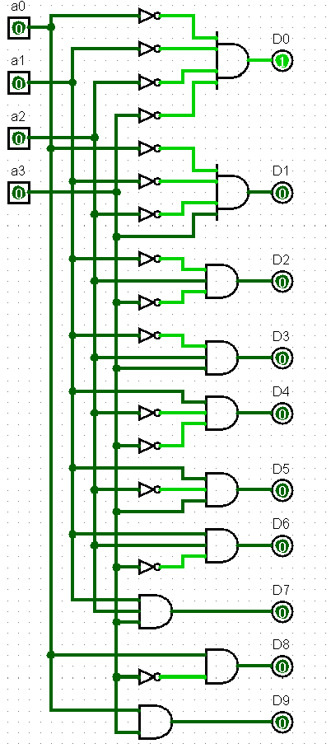
How the decoder works
Each combination of inputs will assert a unique output. If we enter 0000 D0 is high.
And if the input is 0001
D1 is high and so on according to the truth table in the next slide.

Slide 23
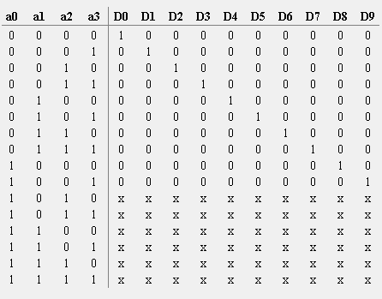
The Truth table for 7-segment Decoder
X indicates to don’t care condition

Slide 24
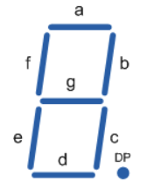
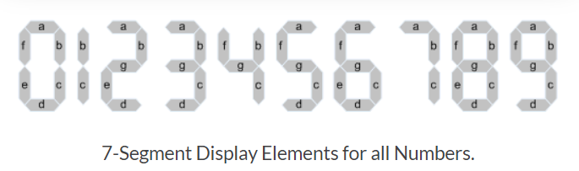
Continued… Using the outputs of the decoder to get the Boolean functions of each segments of the 7 segment. So in order to display the number “3” for example, segments a, b, c, d and g would need to be illuminated. If we wanted to display a different number or letter then a different set of segments would need to be illuminated.

Slide 25
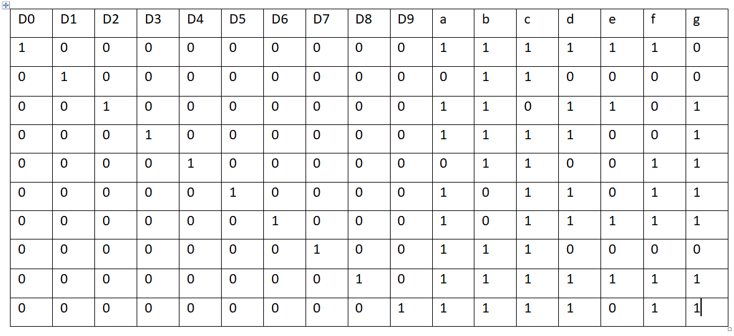
According to this truth table, the next circuit was implemented “using the min-terms”.

Slide 26
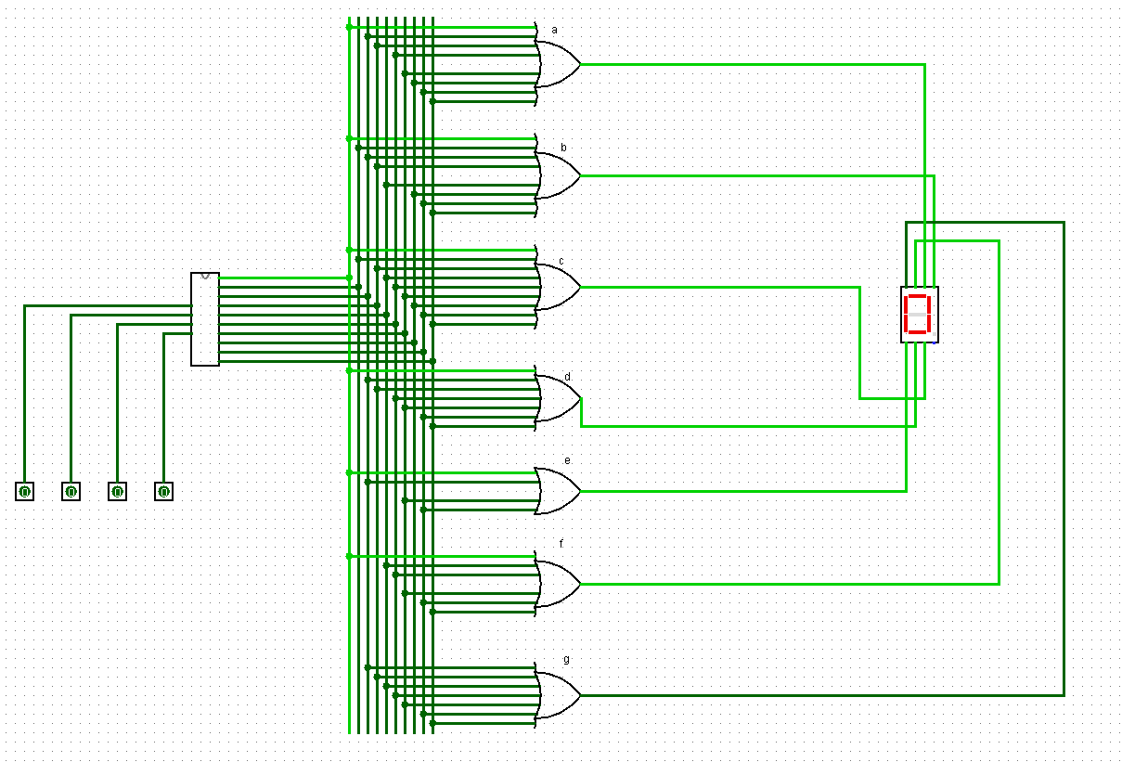
The Logisim implementation ..

Slide 27
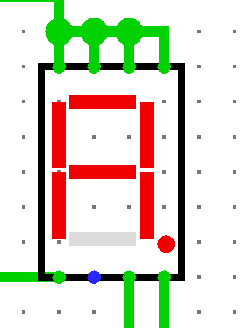
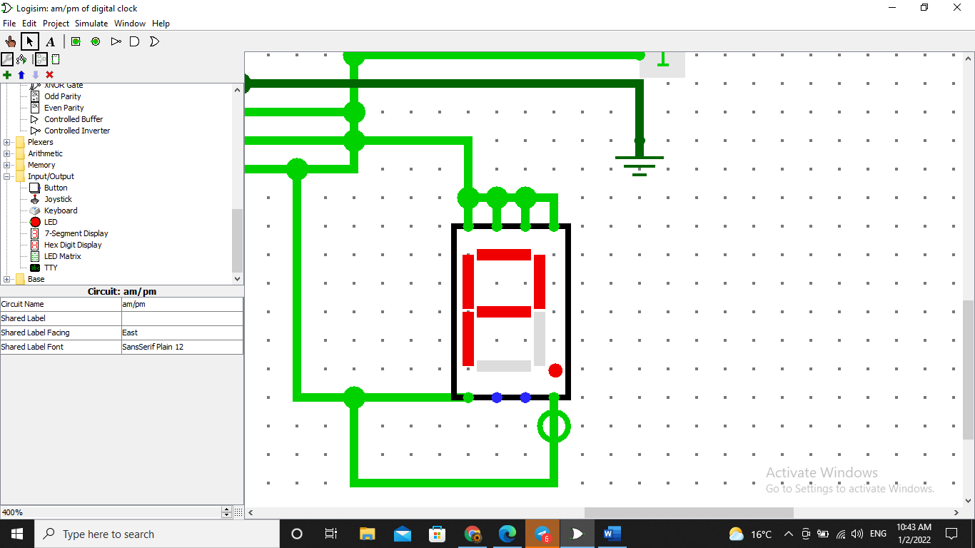
Am /Pm Displaying
To display an indicator for time laps [ Morning / Evening ], we decided to use symbol , on a 7-SEG
A
P

Slide 28
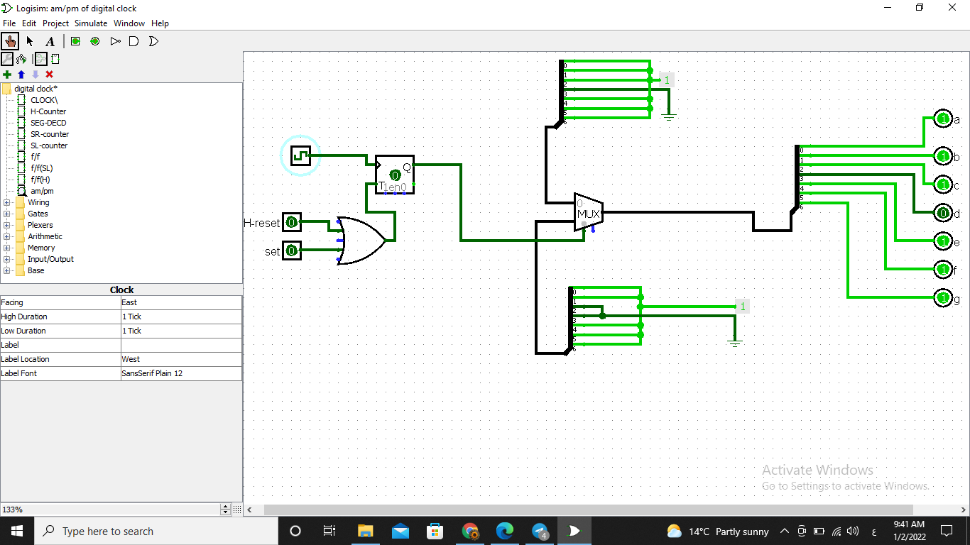
Am / pm Design

Slide 29
Am / pm Design
Knowing the signals that produces and on a 7-SEGMENT, we applied it on a 1-2 multiplexer ,whereas, when the signal is low on the multiplexer selector, it passes A, otherwise it does pass P, when high signal.
To choose the selector signal; There was two cases in which the state will change to or vice versa, and that's when:
The clock state is set by the User.
Over-Flow occurs on the Hour Counter.
A
P
A
P

Slide 30
Am / pm Design
So we used a T flip-flop that will do the toggling job between ( - ) states.
Where we enrolled the two cases that triggers the output to toggle on an OR Gate to the T flip-flop, so that, it will toggle the current output whenever any of the cases is achieved.
A
P

Slide 31
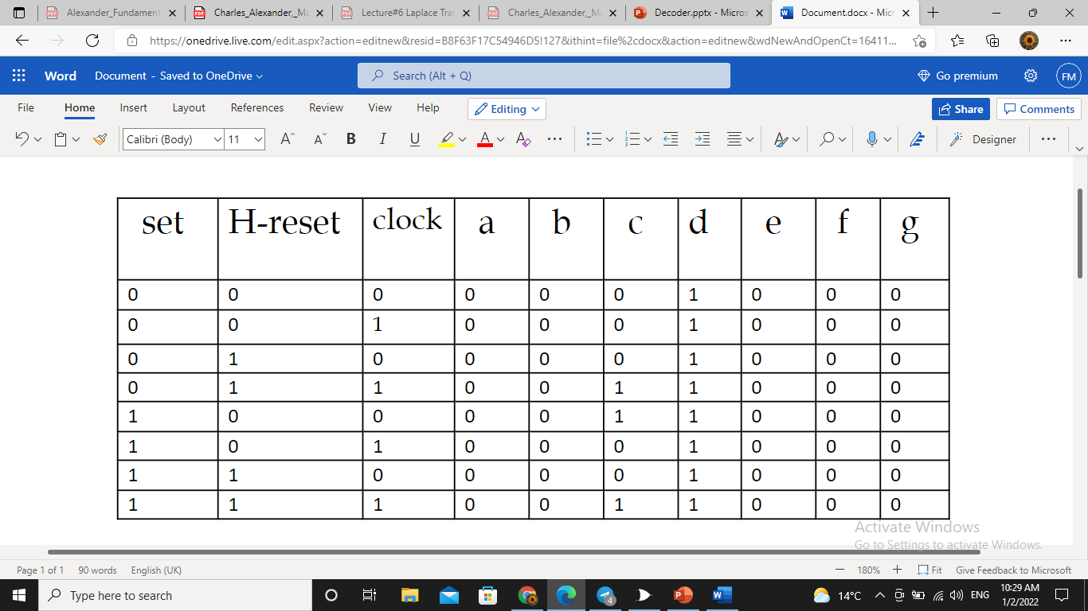
Am / pm State table

Slide 32
Conclusion...
In the end, we would like to point out how much practical benefit we have gained from the collective work on this project. We learned how to plan well for projects. And start studying and analyzing before implementation. We also acquired the skills of sourcing, continuous experience, and appropriateness of design for practical implementation. Perhaps also thinking outside the box and not stopping at standardized and traditional solutions to the problems we face. The payoffs of working on this small project were great. And our happiness was greater when we completed the work and saw how a simple digital circuit that we use daily without realizing its working mechanism until now.

Slide 33
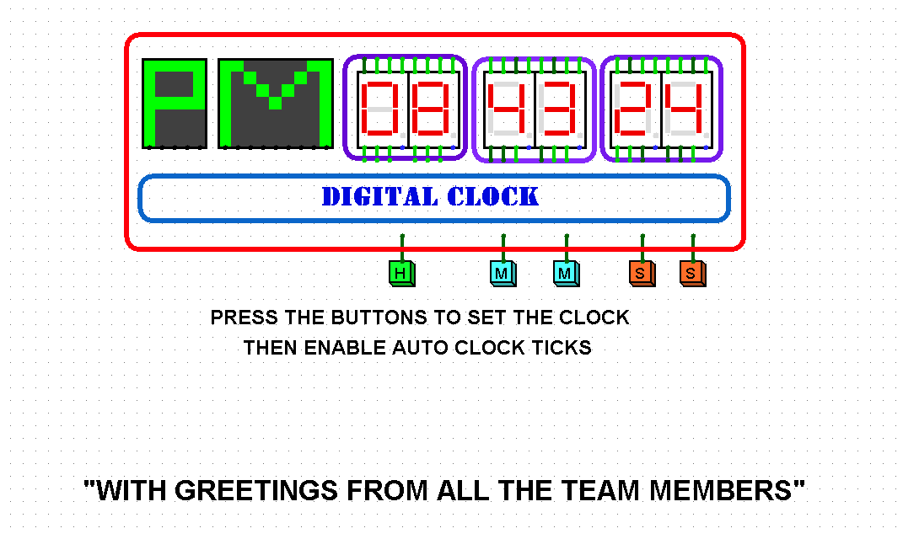
Final Result ..

Slide 34
Resources
Dr. Mohammed Hamdi's lectures notes.
Digital Design By M.Morris Mano-5th-Edition (2013)

